Slide 1
Graph Algorithms
Group 6

Slide 2
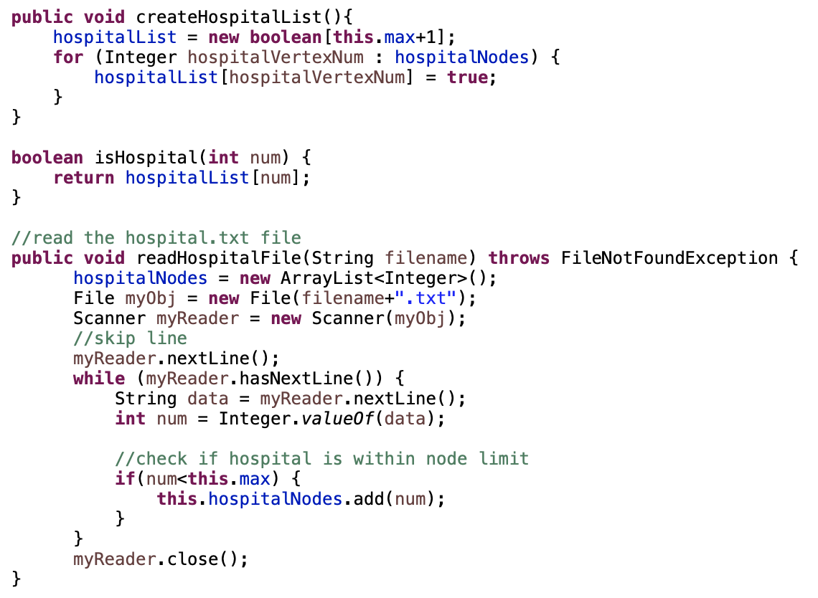
Hospital Array
2
1
4
6
3
5
7
We create a boolean array to store the hospitalList, and hospital nodes are set to True.
Notes:
hospital is at node 4

Slide 3
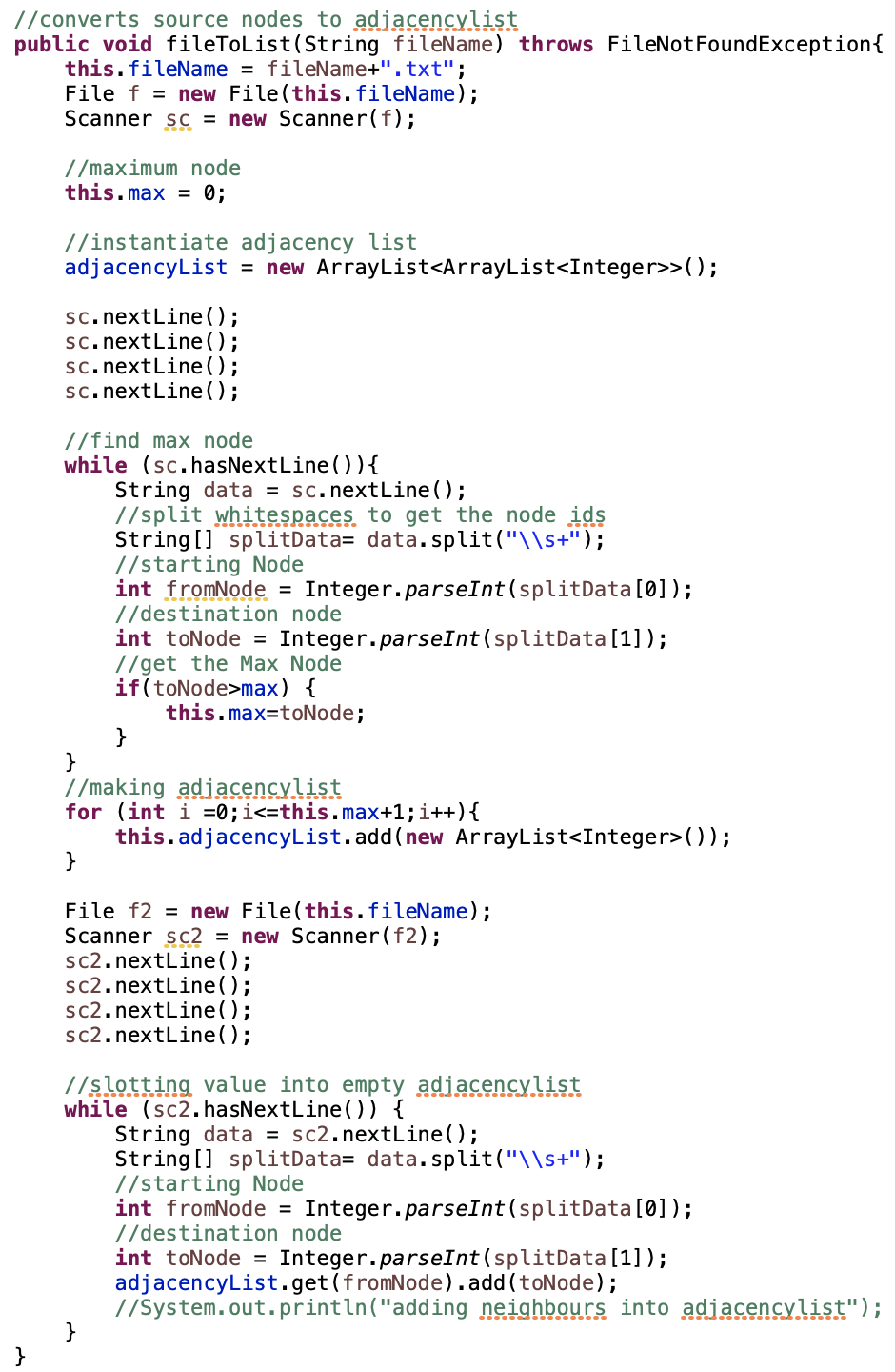
Adjacency List
Using an array to represent neighbouring vertices.
Our adjacency List is made by a data structure: ArrayList of ArrayList
We noticed that TotalNoOfNodes not equal to max node number
Therefore we loop through all the nodes once to find the max node number
We make an empty adjacency list of max node number [ [], [],...,[] ]
Lastly we loop through the source file again to append the nodes onto the adjacency list

Slide 4
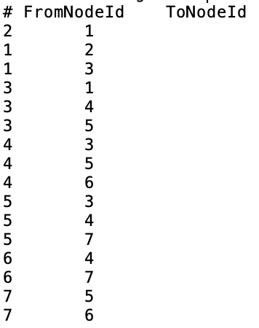
Adjacency List
2
1
Using an array to represent vertices.
1
4
6
1 : 2, 3
2 : 1
3 : 1, 4, 5
4 : 3, 5, 6
5 : 3, 4, 7
6 : 4, 7
7 : 5, 6
3
5
7

Slide 5
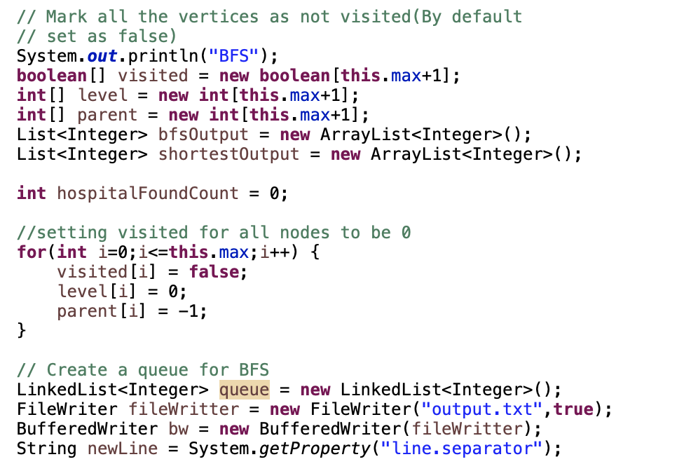
Breadth-First Search (BFS)
We keep track of
visited: nodes that have been visited
level: the level of each node (also known as distance from source node)
parent: the parent of each node
We store the the order of each BFS traversal in bfsOutput.
Array shortestOutput stores the shortest path.
We also create a queue to keep track of nodes we need to explore.
Notes:
Initialize:
visited = False
level = 0
parent = -1
// add code

Slide 6
Breadth-First Search (BFS)
2
1
4
6
queue
1
bfsOutput
3
5
7
1
First, we mark the source code (current node) as visited and enqueue it.
We enter the while loop as long as the queue is not empty:
We get the first element in the queue, 1, and append it into bfsOutput.
Notes:
source node is 1

Slide 7
Breadth-First Search (BFS)
2
1
4
6
queue
2
3
bfsOutput
3
5
7
1
First, we mark the source code (current node) as visited and enqueue it.
We enter the while loop as long as the queue is not empty:
We get the first element in the queue, 1, and append it into bfsOutput.
Then we explore all the adjacent vertex of 1 using a for loop.
If a vertex is not yet visited, we set it to:
visited = true,
parent = 1,
level to be level of current node+1.
We then enqueue it.

Slide 8
Breadth-First Search (BFS)
2
1
4
6
queue
3
bfsOutput
3
5
7
1
2
We continue with the while loop as long as queue is not empty.
We get first element in the queue, 2, and append it to bfsOutput.
Then we explore all adjacent vertex of 2, which in this case is 1, and since 1 has been explored, we move on to the next element in the queue.

Slide 9
Breadth-First Search (BFS)
2
1
4
6
queue
4
5
5
bfsOutput
3
5
7
1
2
3
4
We continue with the BFS until we reach the hospital node, 4.

Slide 10
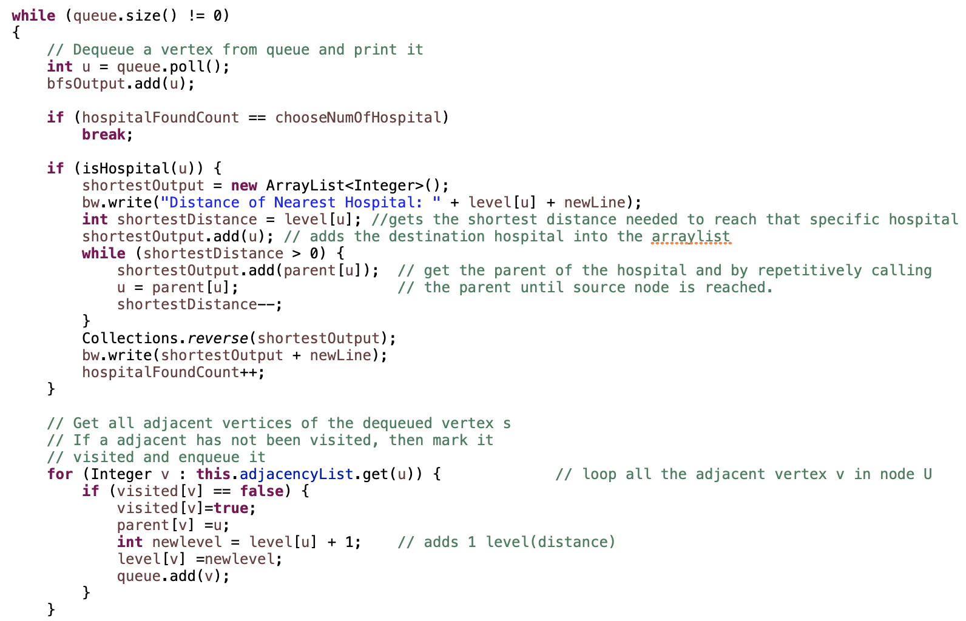
Breadth-First Search (BFS)
In every while loop, we check if the current node is a hospital node.
If it is a hospital node,
We create a new array to store the shortest path from the source node to that hospital node, shortestOutput.
The distance is the level of the hospital node from the source node.
We use a while loop to add to shortestOutput, by adding the parent node of each node until source node is reached.
shortestOutput is then reversed to get an array that represents the shortest path.

Slide 11
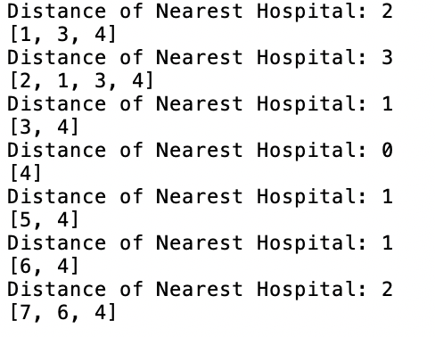
Breadth-First Search (BFS)
By carrying out BFS on every source node, we arrive at this output:
2
1
4
6
3
5
7

Slide 12

Time Complexity for preprocessing
A: Creation of boolean array, with a constant time complexity of O(1)
B: We use a for loop to iterate through the list of hospital nodes to tag as hospital. Worst case: all nodes are hospitals, time complexity would be O(V).
C: A function that simply returns whether the node is a hospital, from the array. This takes constant time O(1).
A
B
C

Slide 13
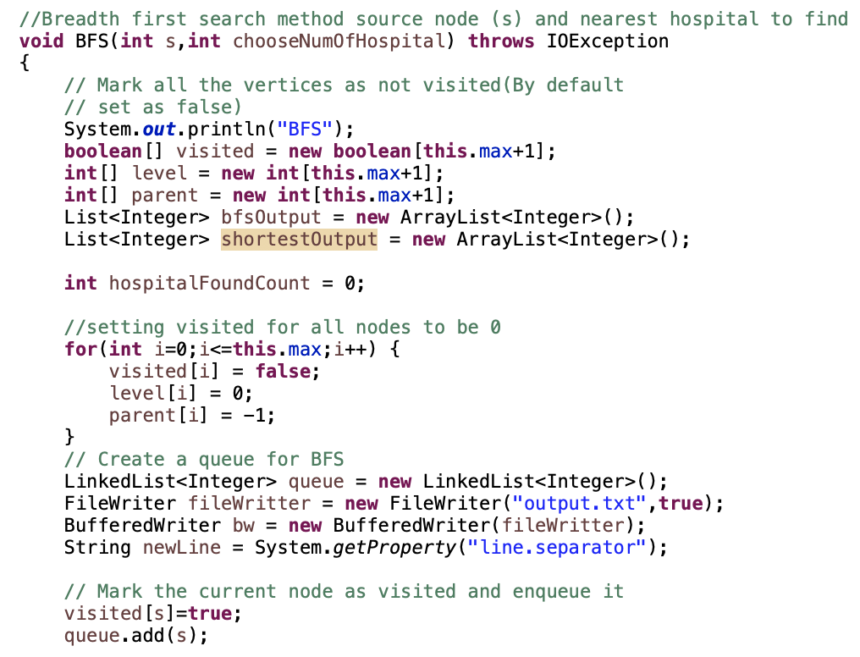
Time Complexity for preprocessing
Initialization of the Algorithm:
D: Execute a single time to create arrays, O(1)
E: Execute V+C times, where V is the number of vertices and C is the skipped nodes. We assume the skipped nodes are negligible
Time complexity = O(V+C) = O(V)
F: Execute a single time to create a queue, set current node as visited, add to queue, O(1)
D
E
F
F

Slide 14
Time Complexity of BFS
G: Gets shortest distance of hospital by repeatedly calling the parent node until source node is reached. Hence worst case is when we call all nodes, O(V).
H: For this statement, the worst case is when all the nodes have to be traversed for the shortest output. Hence O(V)
I: We check if the node being examined is a hospital. The comparison itself takes a unit in time for the if statement since isHospital() is a retrieval from boolean array. Hence O(1).
J: The execution of the break statement depends on the number of k nearest hospitals to be displayed. The worst case would be when V-1 hospitals are required. V-1 comparisons are done, hence O(V)
K: Each adjacent vertex is looped. Number of adjacent vertices = Number of edges. Hence, the time complexity would be O(E).
Hence, the time complexity of our algorithm is:
O(V) + O(V) + O(V) + O(V) + O(E) = O(V+E)
J
G
I
H
K

Slide 15
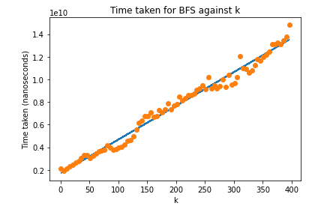
Empirical Analysis
k = number of hospitals selected to be displayed by the user.
The graph plots Time taken for BFS against k.
As the search for the nearest k hospitals increases, time taken for BFS increases linearly.

Slide 16
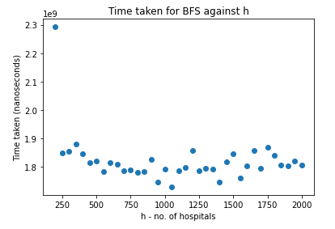
Empirical Analysis
h = number of nodes that are hospitals in the graph.
The graph plots the time taken for BFS against h.
As we see, the time taken for the algorithm is not directly dependent on the number of hospital nodes present in the graph.

Slide 17
Demo

Slide 18
Thank you!

